Slide 1


Neural Network Demos

Slide 2

Architecture

Slide 3

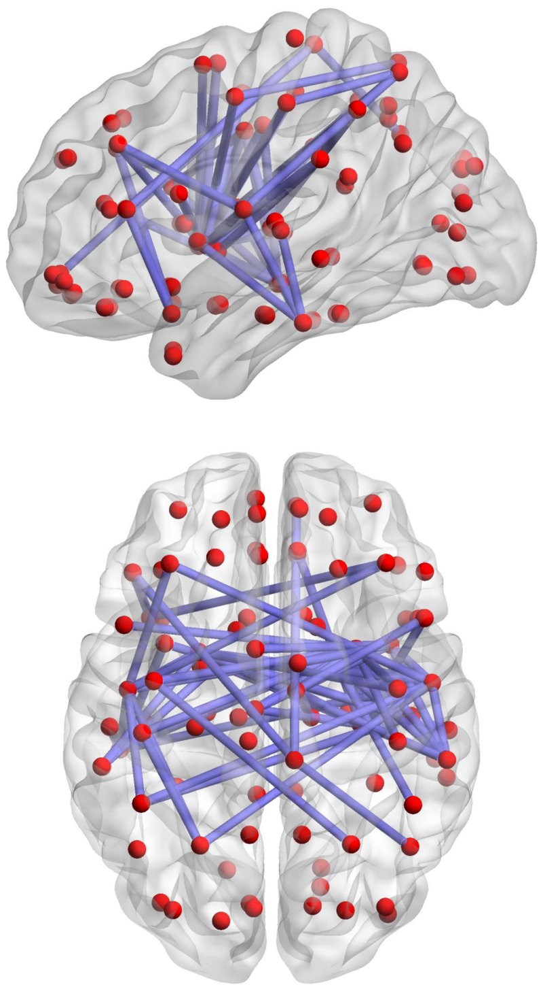
Artificial Neural Networks
The Brain
vs

Slide 4
Convolution Neural Network

Slide 5

LeNet: CNN Architecture based

Slide 6
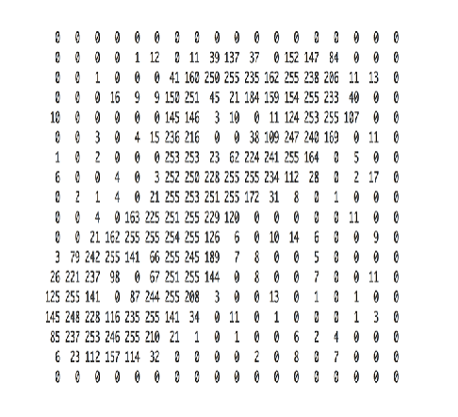
Image Encoding

Slide 7
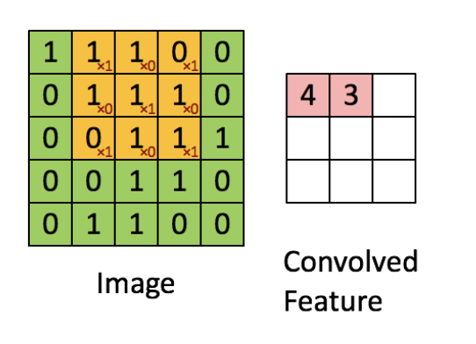
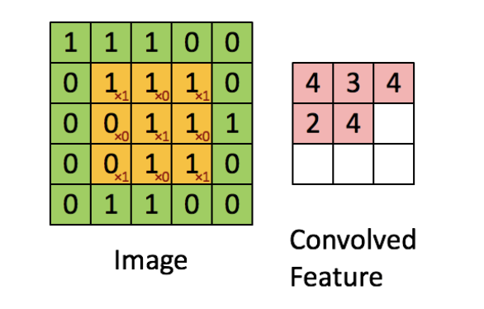
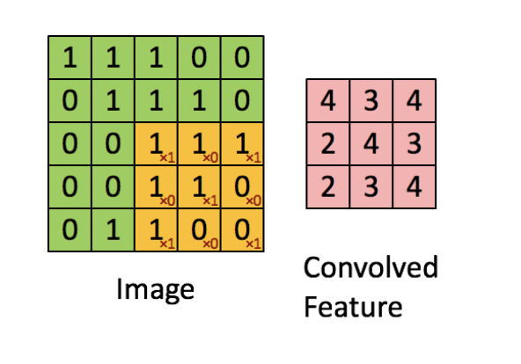
Convolution Layers
*

Slide 8
Convolution Layers Continued
*

Slide 9
Pooling Layers

Slide 10
Fully Connected Layers

Slide 11
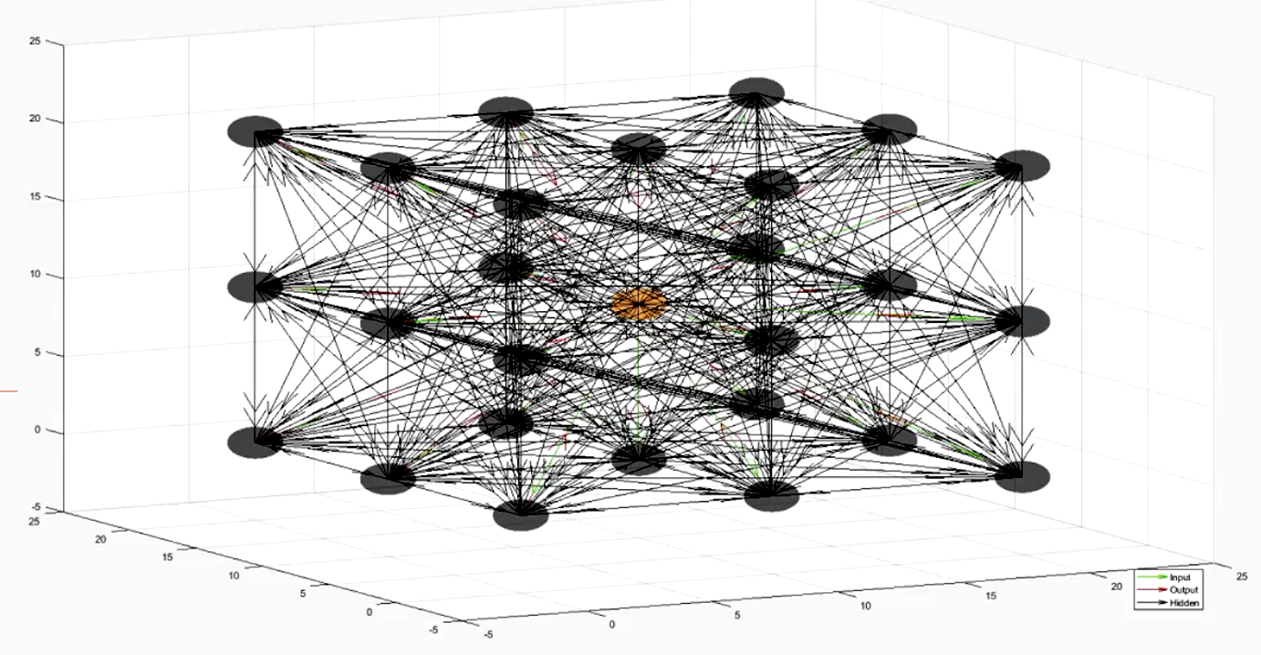
CNN+Boltzmann Machine Biological Network Simulation
Probabilistic Hidden Nodes
Input
/Convolution
/Output Node

Slide 12
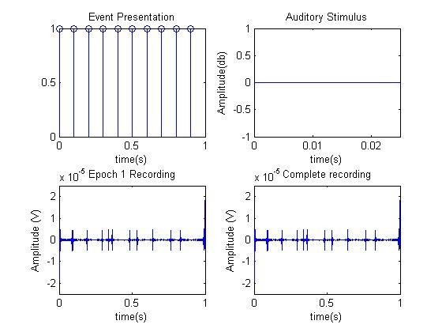
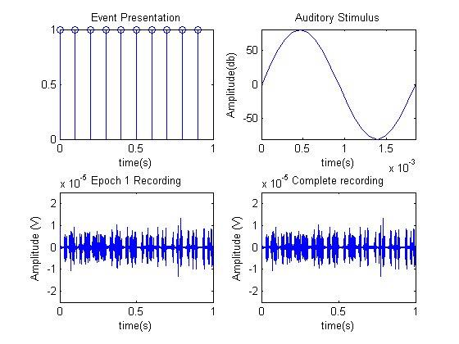
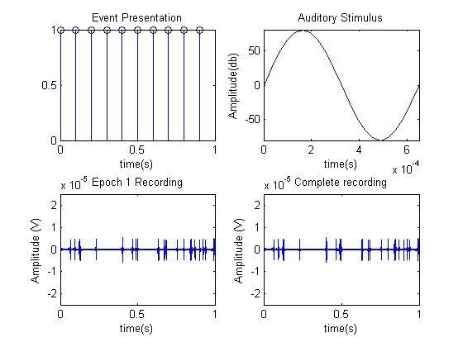
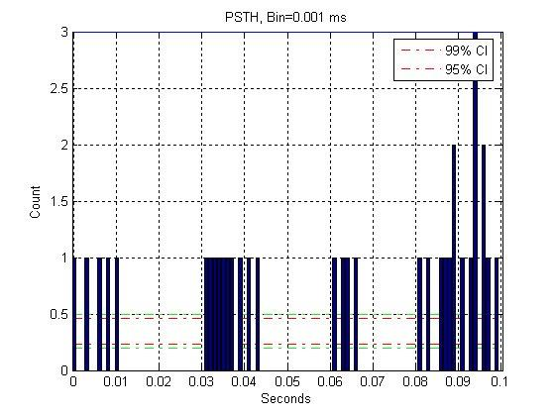
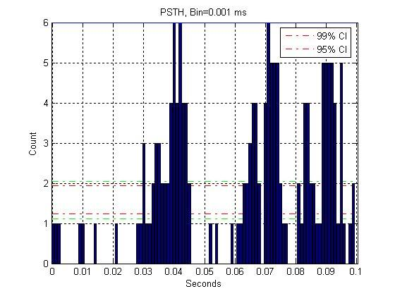
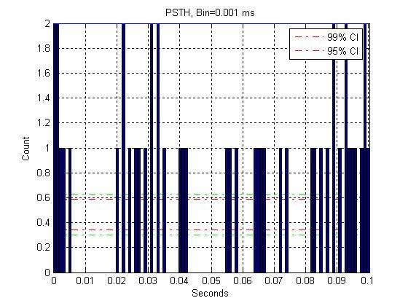
Simulation

